Slide 1
Continuous time
財金 洪敏誠
2009/08/14

Slide 2
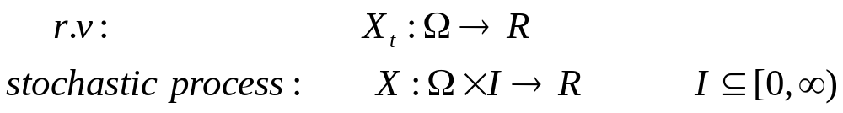





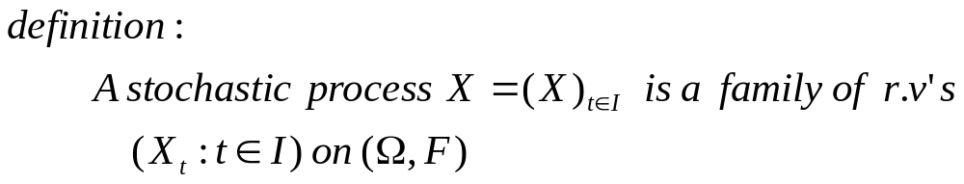

Slide 3
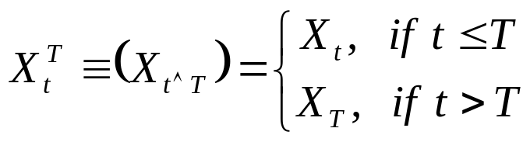


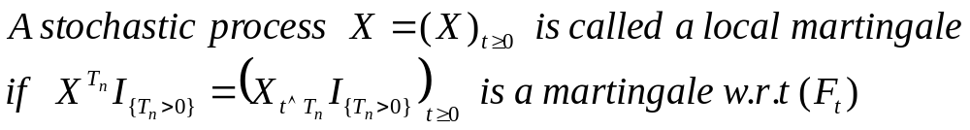
Local martingale

Slide 4
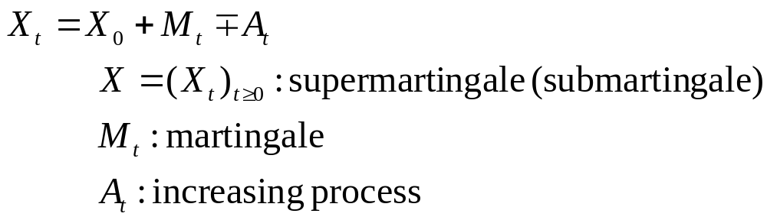
Doob-Meyer decomposition

Slide 5
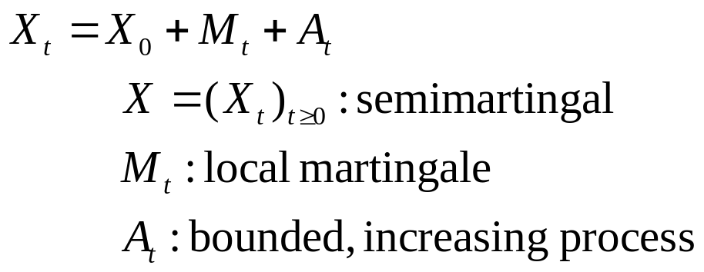
Semi-martingale

Slide 6
martingale
Local martingale
Semi-martingale

